Slide 1

DriverPass System Analysis
Jesus Rodriguez-Luna
Notes:
Good afternoon everyone. Thank you for meeting with us today. I am excited to walk you through what we designed for the DriverPass system.

Slide 2

System Requirements
Internet connection is required to use or update the system Adding or removing major features requires a developer Payment processing depends on a third-party service DMV content updates must be reviewed and applied by an admin
Notes:
First, let’s talk about the system requirements.
There are two main types. The first type focuses on what the system must do. Customers need to create an account, log in securely, and manage their own driving lessons. They can schedule, cancel, or reschedule lessons directly from the website. This gives them full control over their appointments without needing to call the office.
The second type focuses on how the system performs. The system must protect customer information and payment details at all times. It also needs to work on desktops, laptops, and phones so both customers and staff can access it anywhere. These requirements make sure the system is not only functional but also reliable and secure.

Slide 3
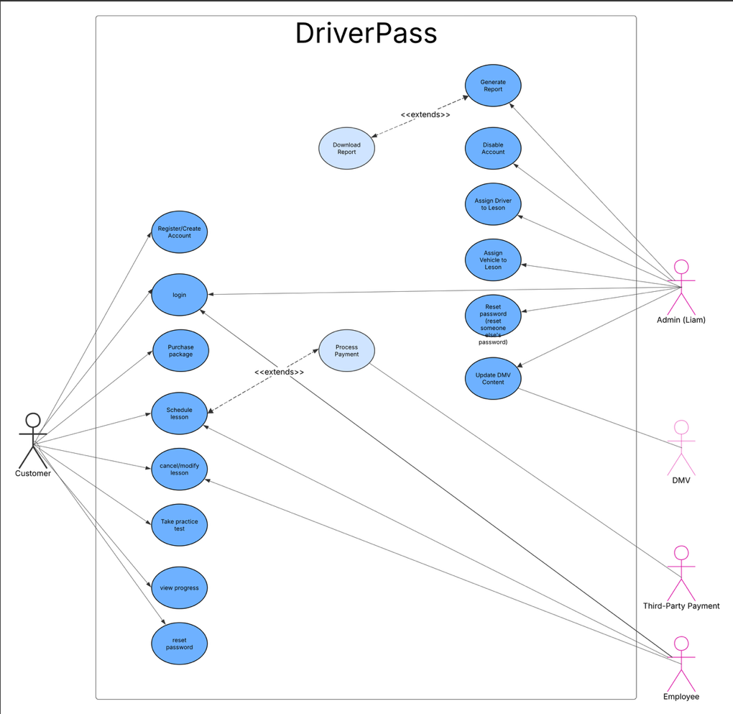
Use Case Diagram
Notes:
I want to give you a simple overview of how everyone interacts with the system.
Customers can create accounts, log in, purchase lesson packages, schedule or cancel lessons, take practice tests, and view their progress. These are all features you said were important so students can manage things on their own.
The staff has different levels of access. The administrator can reset passwords, manage accounts, and/or disable users, assign drivers and vehicles, generate reports, and update DMV content.
We also included the DMV as an outside connection since the system receives updates when rules change. A third party payment service handles transactions securely so sensitive card information is never stored in your system.

Slide 4
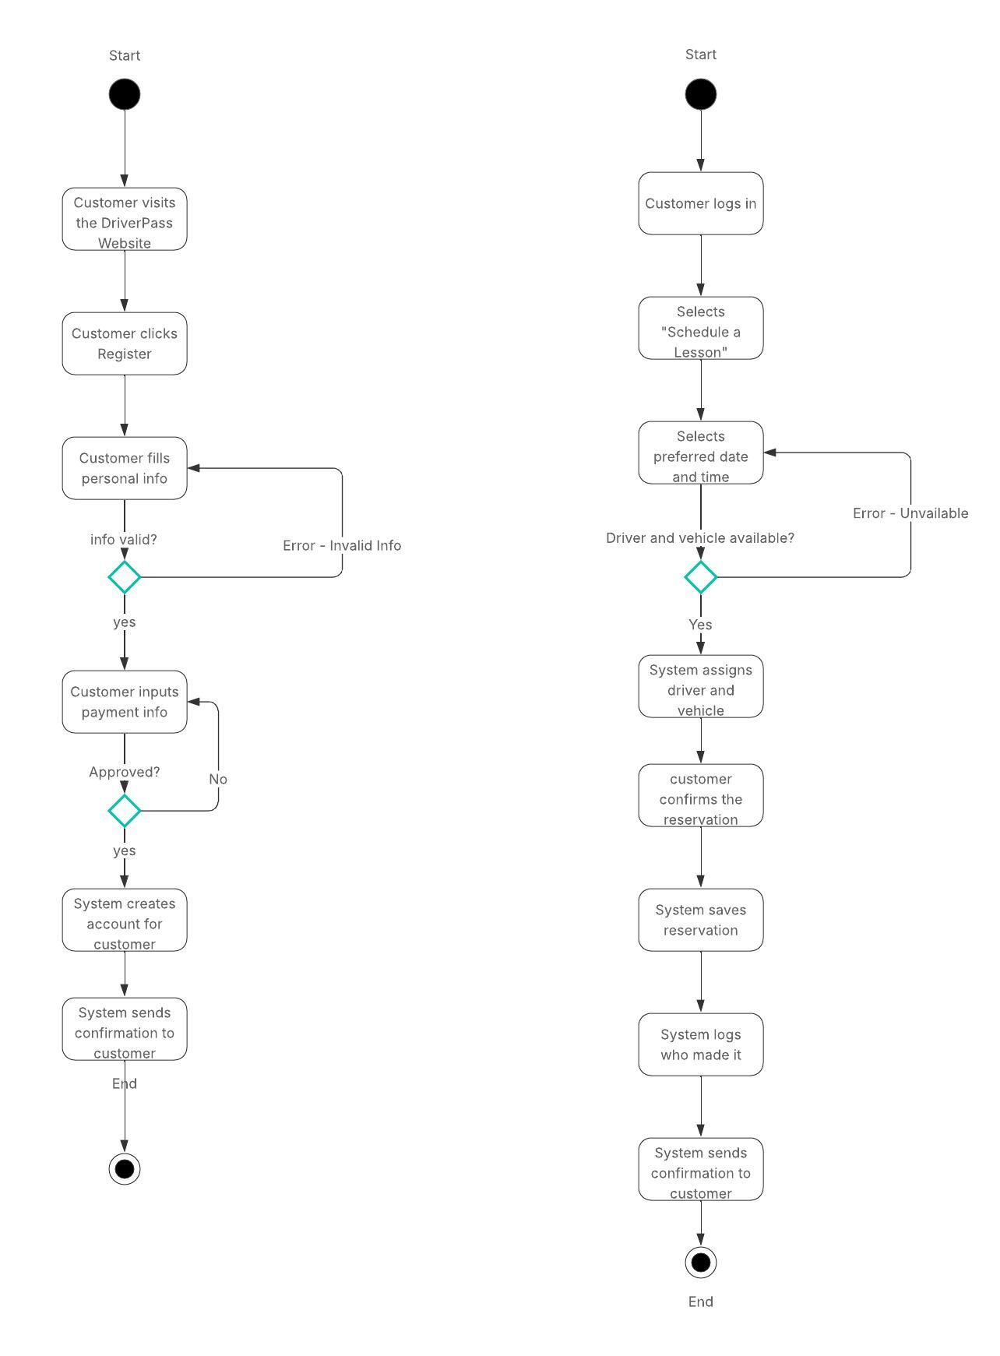
Activity Diagram
Notes:
Now I will walk you through what happens when a customer schedules a lesson. (Diagram on the right).
First, the customer logs into their account. Then they choose the option to schedule a lesson and select a date and time. The system checks to see if a driver and vehicle are available. If nothing is available, the customer selects a different time.
Once a driver and vehicle are available, the system assigns them automatically. The customer reviews the details and confirms the reservation. The system saves the appointment, records who made it, and sends a confirmation.
This prevents double bookings and keeps a clear record of every reservation.

Slide 5
Security
Secure login required for all users Each user only sees what they are allowed to access All passwords are encrypted and protected Admins can reset passwords or block accounts All reservation changes are tracked and logged All data is encrypted during transmission
Notes:
Security is a top priority.
Every user must log in with a username and password. Each role only sees what they need to see. Customers cannot access reports, and staff members cannot access features outside their role.
Passwords are stored securely and cannot be read even if someone accessed the database. All information sent through the system is encrypted. Customers can reset their own passwords if needed.
The admin can reset or block accounts at any time. The system also records every reservation change so there is always a clear history of who did what and when.

Slide 6
System Limitations
Internet connection is required to use or update the system Adding or removing major features requires a developer Payment processing depends on a third-party service DMV content updates must be reviewed and applied by an admin
Notes:
Every system has limitations, and I want to try to be clear about them.
First, an internet connection is required to use the system. Reports can be downloaded, but changes cannot be made offline. This helps prevent duplicate or conflicting data.
Second, adding major new features would require a developer. The system can grow with your business, but larger changes go beyond what an administrator can do alone.
Third, payment processing is handled by an outside service. This protects you because your system does not store credit card information, but it does mean you depend on that service being available.
Finally, when the DMV releases updates, an administrator must review and approve them before they go live. This ensures you always stay in control of what your customers see.

